Slide 1
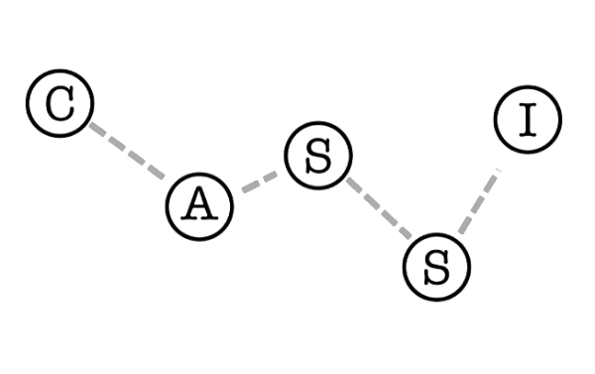
Diversity & Feminism in Science: Epistemic Injustice in Society
Justin Alejandro, River Schmidt-Eder, Isabelle Winnick, William Yang
July 26, 2024

Slide 2
Noun PHILOSOPHY
noun: epistemology
The theory of knowledge, especially with regard to its methods, validity, and scope. Epistemology is the investigation of what distinguishes justified belief from opinion.
Epistemology
- Oxford Dictionary

Slide 3
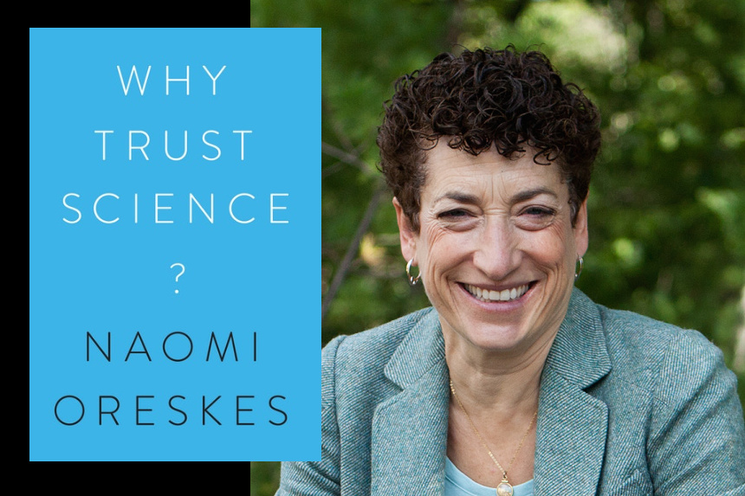
Featured image by Kayana Szymczak and Why Trust Science? © 2019 Princeton University Press. All Rights Reserved

Slide 4

Peer Review
https://theconversation.com/explainer-what-is-peer-review-27797

Slide 5
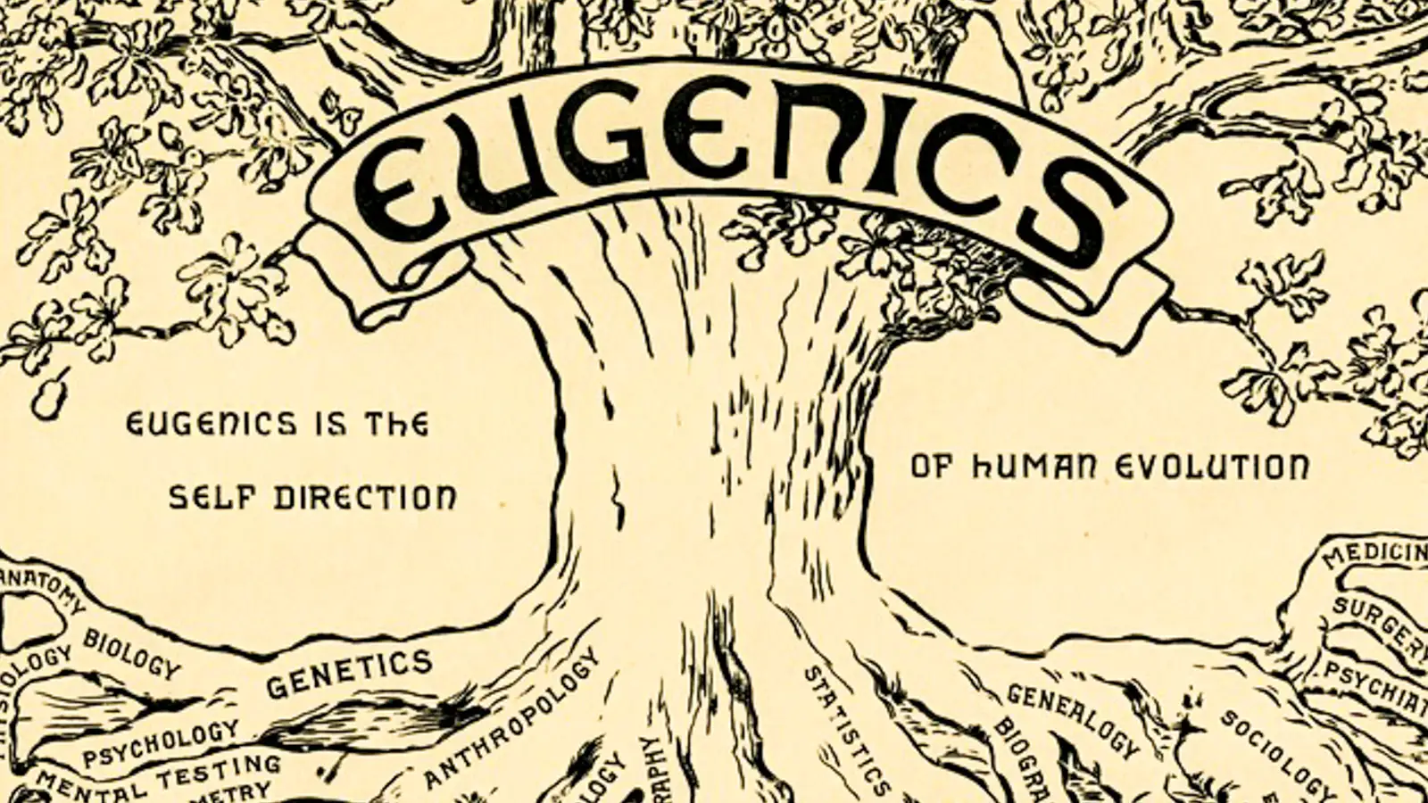
Science gone awry
https://www.genome.gov/about-genomics/fact-sheets/Eugenics-and-Scientific-Racism

Slide 6
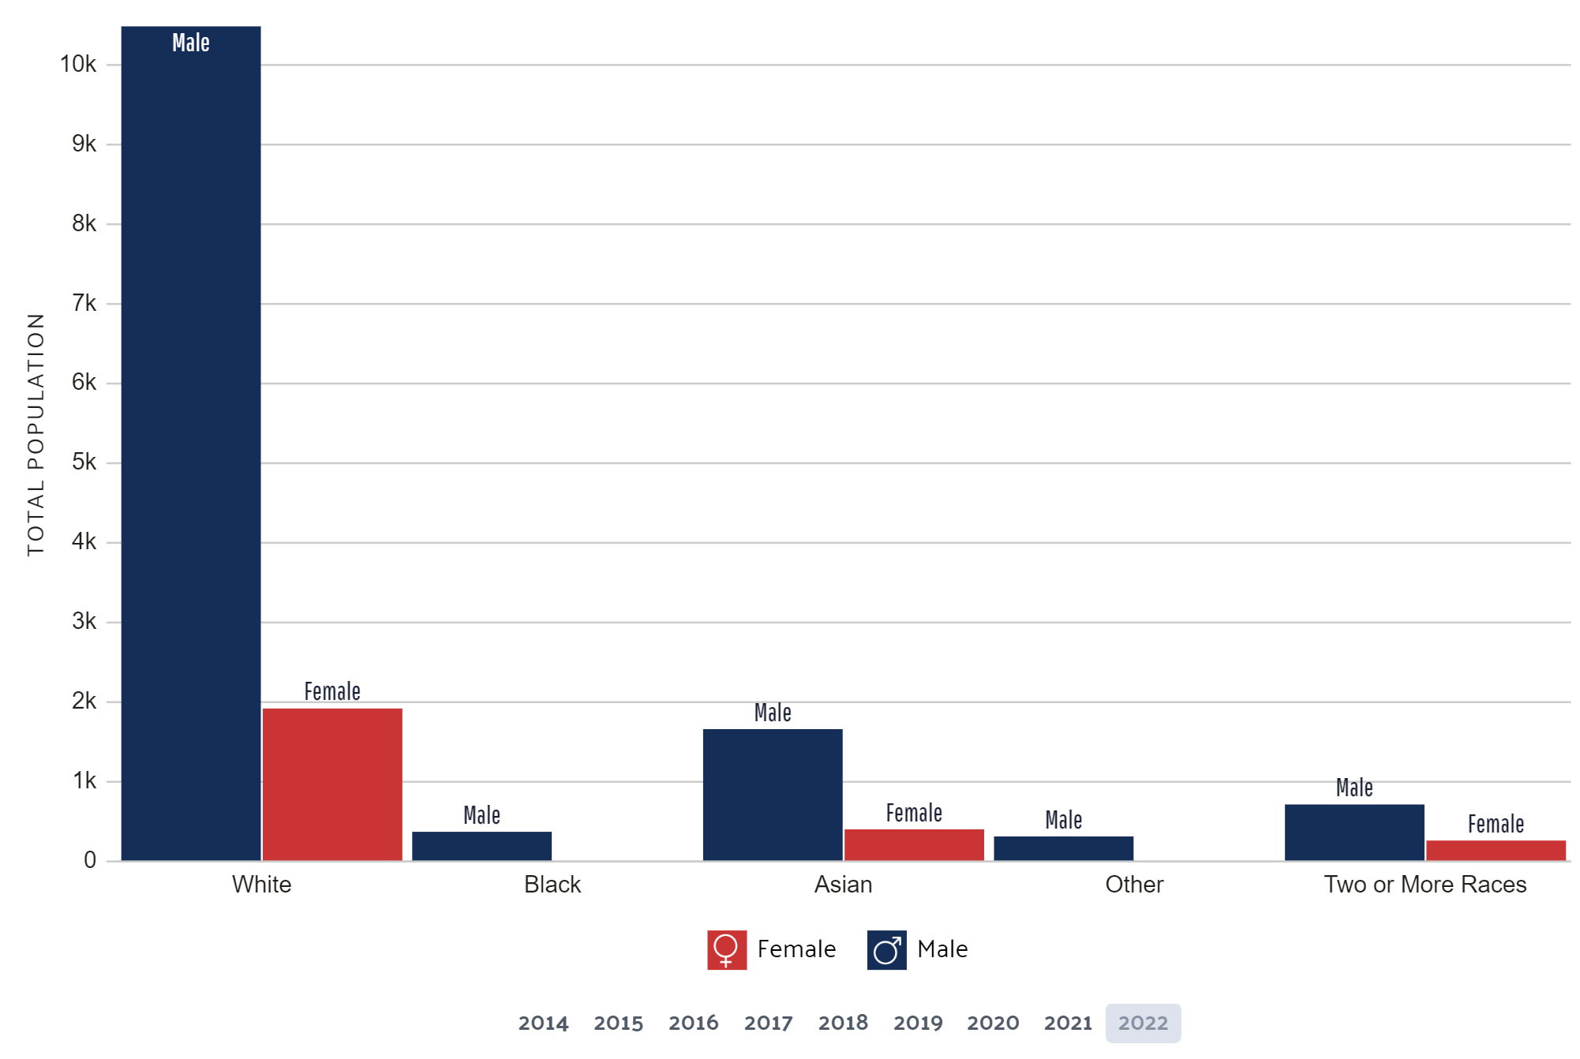
Demographics of Astronomy in the USA
https://datausa.io/profile/soc/astronomers-physicists?ethnicity-gender=genderAllE

Slide 7
(holders of knowledge)
(invalidated; silenced)
Who are the subjects and who are the objects?
-Sally Haslanger, “Objectivity, Epistemic Objectification, and Oppression”

Slide 8
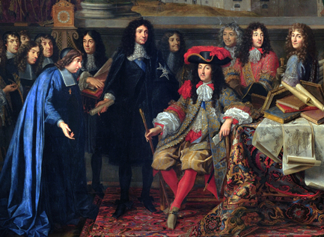
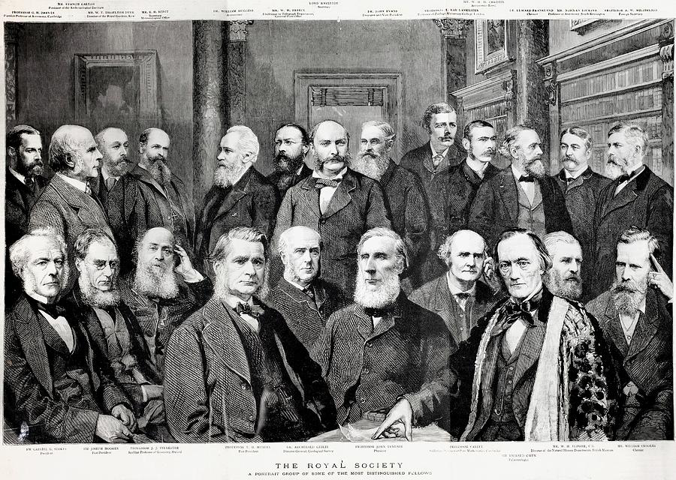
Worthy of scientific trust
Historically…
Academie des Sciences
Paul D. Stewart

Slide 9
—Walter Mignolo (2009, 8).
—Nancy Tuana (2017, 131) .
“In the . . . distribution of scientific labor, the First World had indeed the privilege of inventing the classification and being part of it.”
“The “West” is considered to be the only legitimate tradition of thought able to produce knowledge and the only one with access to “universality,” “rationality” and “truth”.”

Slide 10
How is a dominant epistemology maintained?
Language of Exclusion
Structural Exclusion
Gaslighting
→ downplaying/denying negative experiences
Silencing
→ putting down non-conforming views
Objectifying
→ women and other marginalized groups perceived as a sexual objects/ representatives, not as scientists capable of rational, valuable thought
Explicit exclusion throughout history
Unequal educational experiences
→ lack of funding, opportunities, and explicit degradation of marginalized students
Lack of access to diverse thought
→ Which works are deemed worthy of translation?
→ What publications are included in research databases?

Slide 11
—Naomi Oreskes (2019)
How could science claim to be objective when it largely excluded half the population from the ranks of its practitioners?
How could science claim to be producing disinterested knowledge when so many of its theories embedded obvious social prejudices, not just about gender but also about race, class, and ethnicity?

Slide 12
Scientific Objectivity with Values?
Its Many Varieties
In particular…
Metaphysical Objectivity
Manipulable Objectivity
Convergent Objectivity
Detached Objectivity
Value-Neutral Objectivity
Procedural Objectivity
Concordant Objectivity
Interactive Objectivity
Heather Douglas (2009)

Slide 13
Scientific Objectivity with Values?
Its Many Varieties
In particular…
Detached Objectivity
→ But, there is actually no clear line between evidence and values.
Value-Neutral Objectivity
→ Value-neutral without being value-free. Take into account all values.
Metaphysical Objectivity
Manipulable Objectivity
Convergent Objectivity
Detached Objectivity
Value-Neutral Objectivity
Procedural Objectivity
Concordant Objectivity
Interactive Objectivity
Heather Douglas (2009)

Slide 14
Are we damaging science?
Finding the Truth?
Value Judgements in Science
To describe Objective Reality?
→ How objective is our reality?
To find facts about the world?
To follow the Scientific Method?
→ The hypothetico-deductive model? Inherent logical fallacies in our processes (affirming the consequent).
The search for objective truth through science is inherently flawed.
→ We can never access the ‘truth’.
Science produces justifications, not conclusions.
→ Social epistemology does not damage any rigorous frameworks.

Slide 15
Value judgements provide a means to justify effective decisions
Diverse science is not only strong science, but also beneficial science.

Slide 16

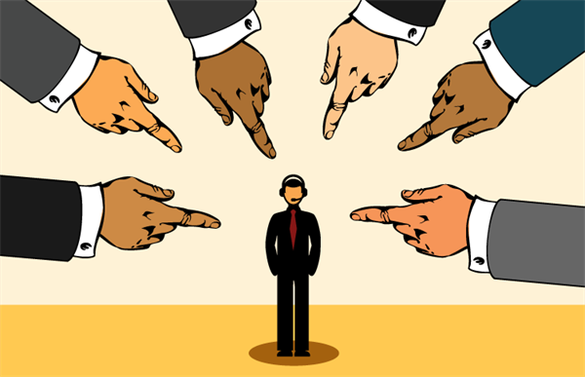


Solutions - River
Hire women and more diverse people for key roles in science and media roles.
Helping the privileged to recognize their privilege and act accordingly.
(Vecteezy)
(Wikimedia Commons)
(Freebie Supply)
(Contact Center Pipeline)
Notes:
Alright, so now we have some solutions for promoting diversity and feminism in science:
First we have: Hire women and more diverse people for key roles in media. Men are associated with science in media at a rate 5X of that of women. So if at all possible we as people should advocate for the hiring of women and more diverse people for key roles in media. This way we can change the public perception of science and hopefully help to change the meta of a disproportionate amount of certain groups in media.
Raising awareness through media and social media:
Encouraging audiences to support films that depict diverse people in STEM can influence studio decisions. We can do that via social media and organizing grassroots social media movements.
Helping the privileged to recognize their privilege and act accordingly:
The implementation of workshops and training sessions into the scientific workspace will likely prove useful toward educating privileged individuals about systemic inequalities in the field.

Slide 17
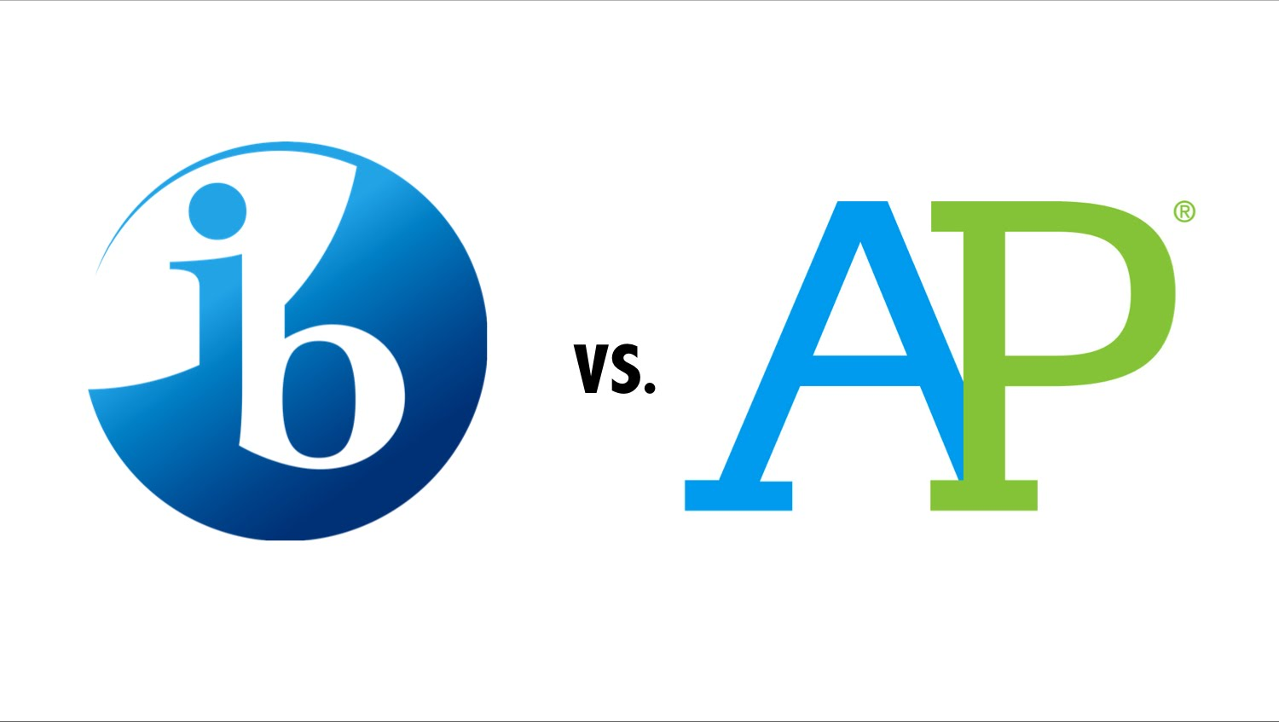
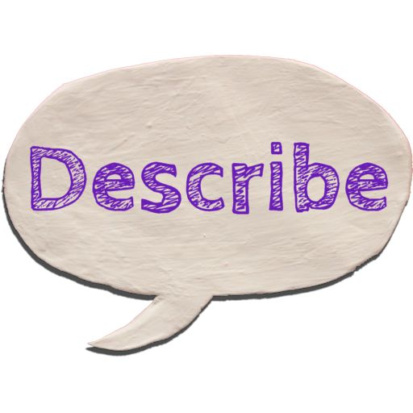
Solutions - River
Increasing the Availability of AP and IB courses:
Changing how we describe our colleagues to avoid promoting biased perceptions:
(Devil’s Advocate)
(Describe Cards)
Notes:
Increasing the Availability of Advanced Placement (AP) and International Baccalaureate (IB) courses in disadvantaged socioeconomic backgrounds:
Advanced courses are crucial for preparing students for STEM fields. They are less available for low-income and minority students. By making them more available we can better prepare more diverse groups for backgrounds in science making them more confident to join the application pool.
- We can also change how we describe our colleagues to avoid promoting biased perceptions:
According to Columbia University “Women’s personalities in cover letters are often described as “caring”, “reliable”, and “team player”.
We can try to counteract this by describing our female colleagues with other traits, for example, “confident”, “motivated”, “passionate”, “dynamic”.

Slide 18
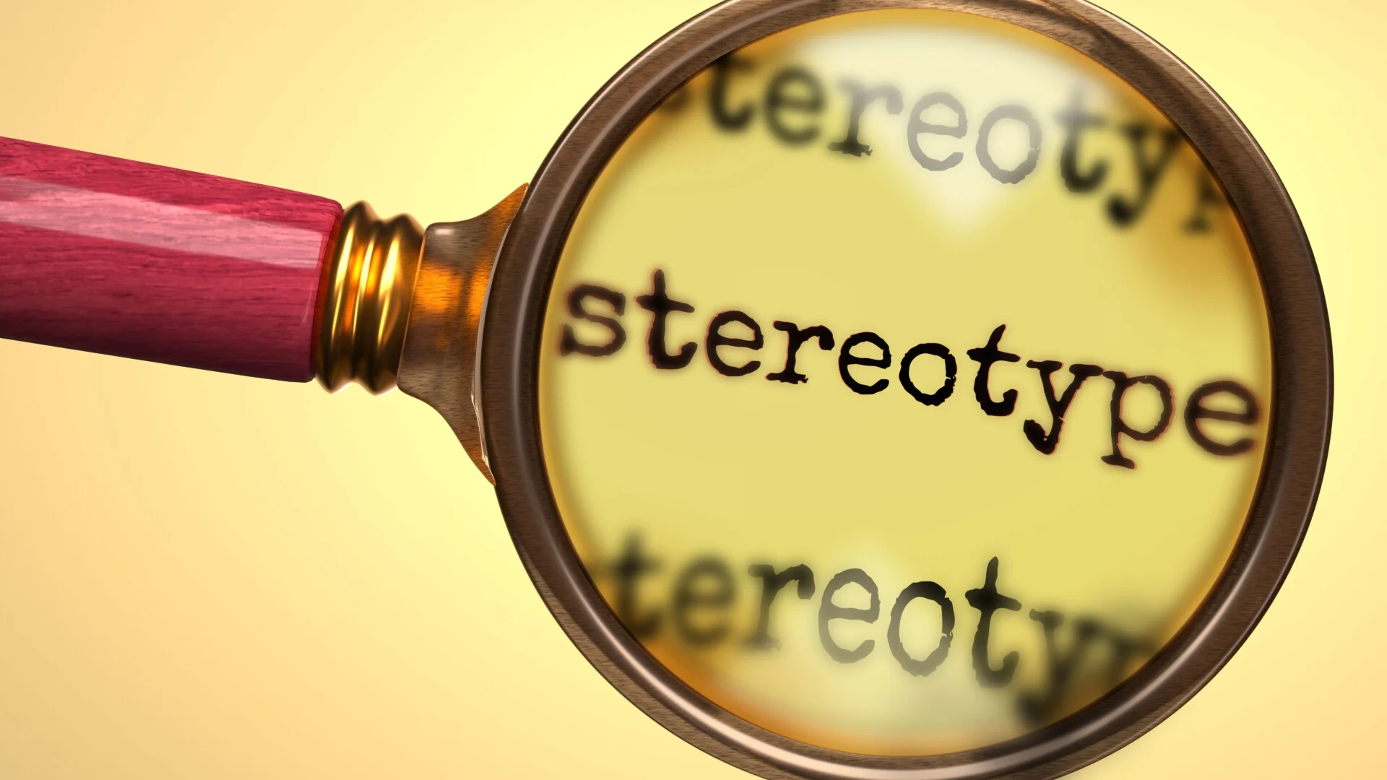

Solutions - River
Dismantling Gender Bias/Sexism and Stereotypes.
Promote welcoming work environments:
(Simply Psychology)
(Hppy)
Notes:
Dismantling Gender Bias/Sexism and Stereotypes:
Stereotypes based on size and looks play a role in how scientists are perceived as well as how welcomed some scientists are made to feel.
Straying away from comments such as “Oh, you don’t look like a scientist” is important for the retention of diverse people in science and it is something that we should aim to do.
Supporting DEI-focused extracurriculars:
As individuals we can support extracurricular STEM programs such as Girls Who Code and extracurriculars such as Project Include (which promotes diversity and inclusion in tech).
We can also promote welcoming work environments:
We can promote welcoming work environments by providing pay equity, flexibility, strong family and medical leave as well as inclusion, and anti-bias training in the workplace.

Slide 19


Solutions - River
Recognize and correct for disparities in funding:
Ensuring diverse committees:
(Shutterstock)
(Getty Images)
Notes:
Recognize and correct for disparities in funding:
It was recently found that White researchers are nearly twice as likely to be awarded a grant than Black scientists of similar academic achievement. Disparities such as this should be recognized.
To fix this we should implement blind review processes removing identifiable information such as names, institutions, and demographics from the review process. Ensuring review panels are diverse in terms of race, gender, and background can lead to more equitable decision-making.

Slide 20
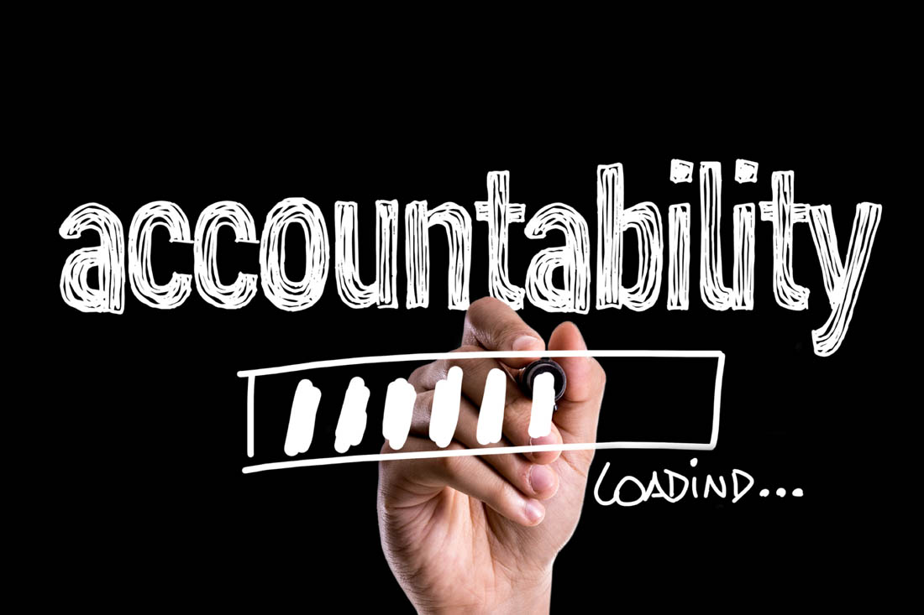

Solutions - River
Create Accountable Systems:
Providing Mentorship:
(ActivTrak)
(HSI)
Notes:
For our last slide of solutions we can:
Create Accountable Systems:
We can also develop mechanisms for holding individuals accountable for their actions ensuring the existence of accessible anonymous reporting systems where individuals can report incidents of discrimination in science against known oppressed groups.
Providing Mentorship:
Lack of minority and female role models in STEM fields can discourage disadvantaged students from pursuing jobs in this field making mentorship programs for these students important. As people who come from underrepresented backgrounds in science it can be important to consider mentorship to help increase the representation of diversity in science.
Considering blind review processes:
To fix this we should implement blind review processes removing identifiable information such as names, institutions, and demographics from the review process.
On our next slide we will consider some discussion questions.

Slide 21
Discussion Questions
What are some of the ways we can uplift diverse perspectives and forms of knowledge?
How can we develop robust, evidence-based science while acknowledging our biases?
What has made you feel included/excluded in scientific discourse?
What role do social and environmental factors play in the representation of minority groups in STEM fields?

Slide 22
Discussion Questions
What are the ethical implications of failing to address diversity and inclusion in STEM fields?
How can early education be reformed to better support and encourage underrepresented groups to pursue careers in science?
What role do social and environmental factors play in the representation of minority groups in STEM fields?
How can the success of diversity and inclusion initiatives in STEM be measured and assessed?
How has your own educational or professional experience been influenced by issues of diversity and inclusion in STEM?

Slide 23

Whoa!
The end

